Slide 1

THIRD EYE FOR THE BLIND
Review 3:
Guide : Prof. ASISH KUMAR DALAI (department of cse)

Slide 2
TEAM DETAILS: BATCH:180272
1)TAHA JUNAID-18BCD7072
2)MOHAMMED TAQI UDDIN-18BCN7050
3)DARRAIN SAA-EYD -18BCN7009
4)SHOAEB-18BEC7067
5)KRISHNA-18MIS7233
6)MAHESH-18MIS7163

Slide 3
THINGS USED IN THIS PROJECT:
Arduino uno
2 ultrasonic sensor
Breadboard
2 Buzzers
Jumper wire
9 v battery
2 button type vibrating motor
Snap power cable male line to battery.

Slide 4
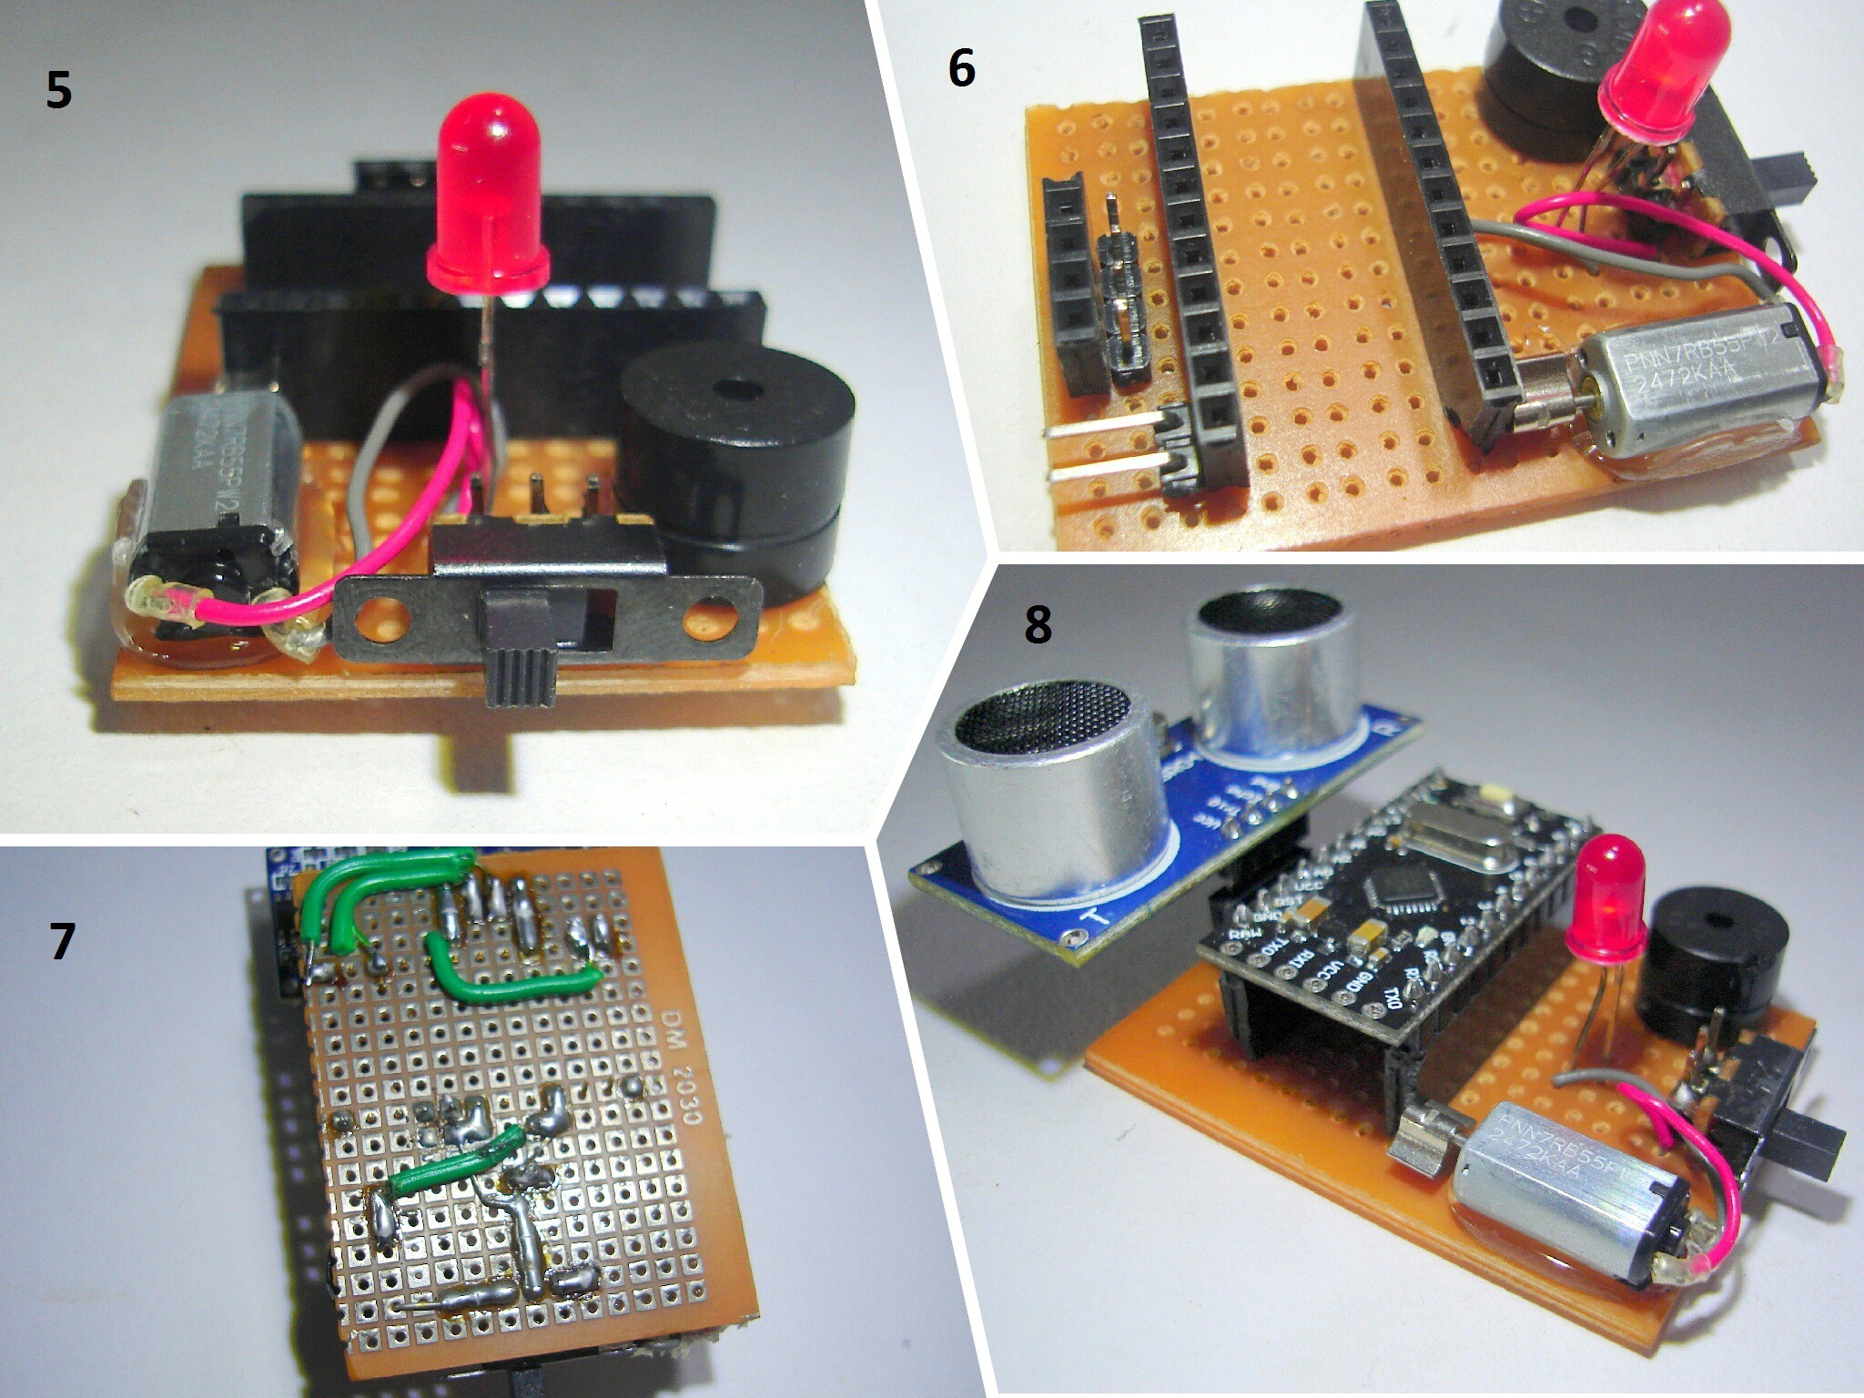
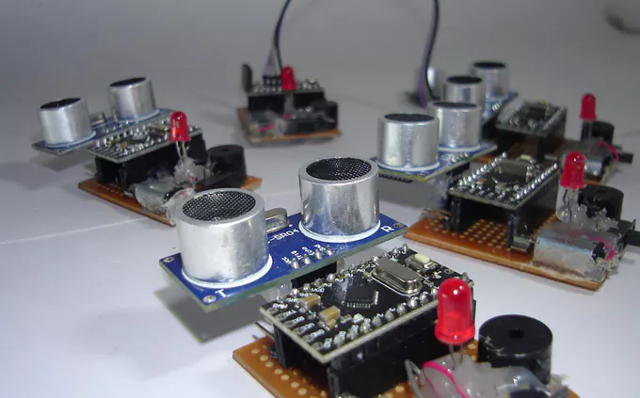
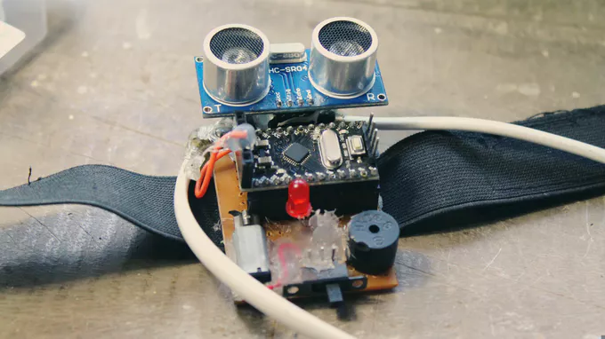
Prototype of the model :

Slide 5
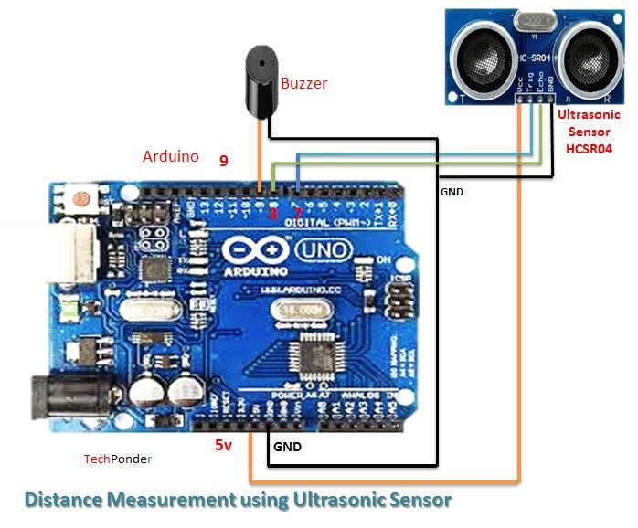
CURRENT CIRCUIT DIAGRAM (using Arduino uno)

Slide 6
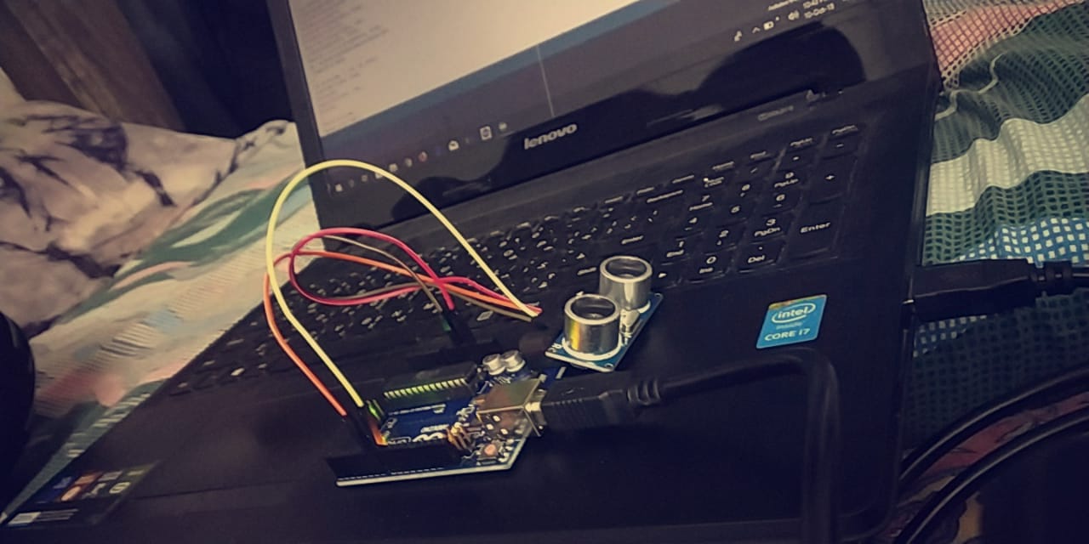
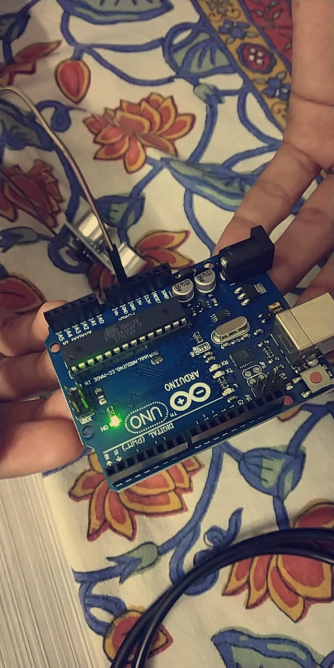
Progress in the1st week:
Received the Arduino Uno
Uploaded the program successfully

Slide 7
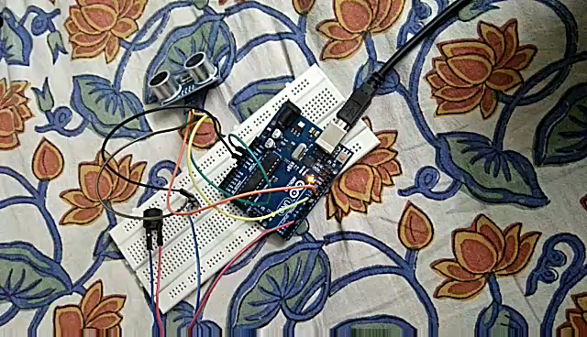
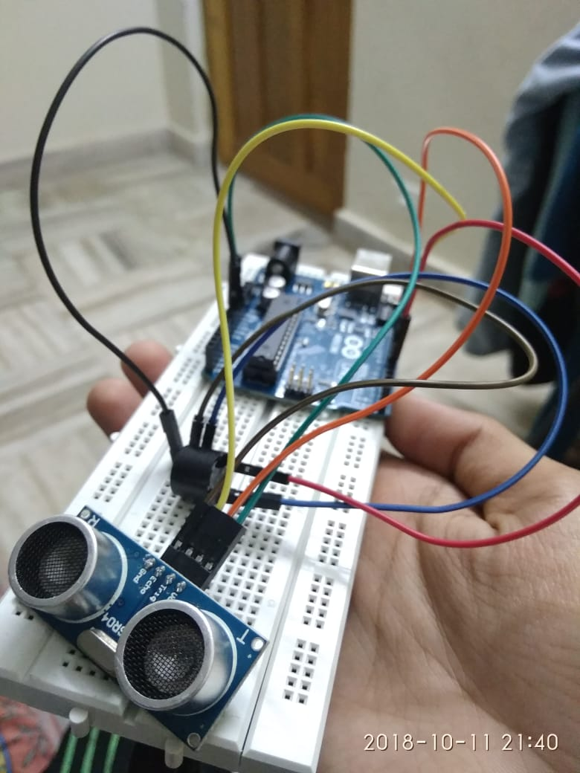
Tested the model with teammates to get positive results.

Slide 8
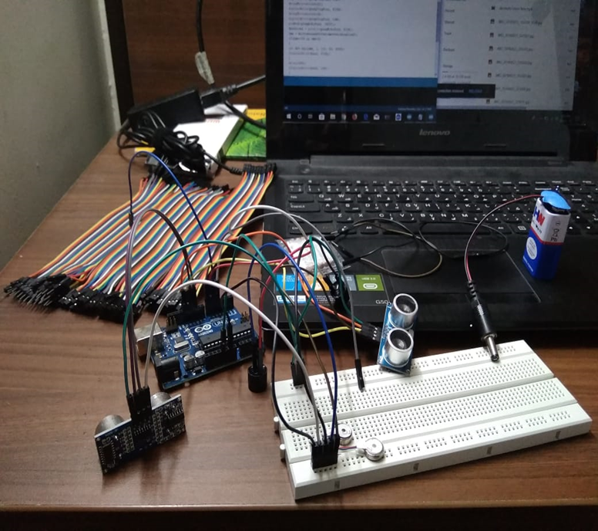
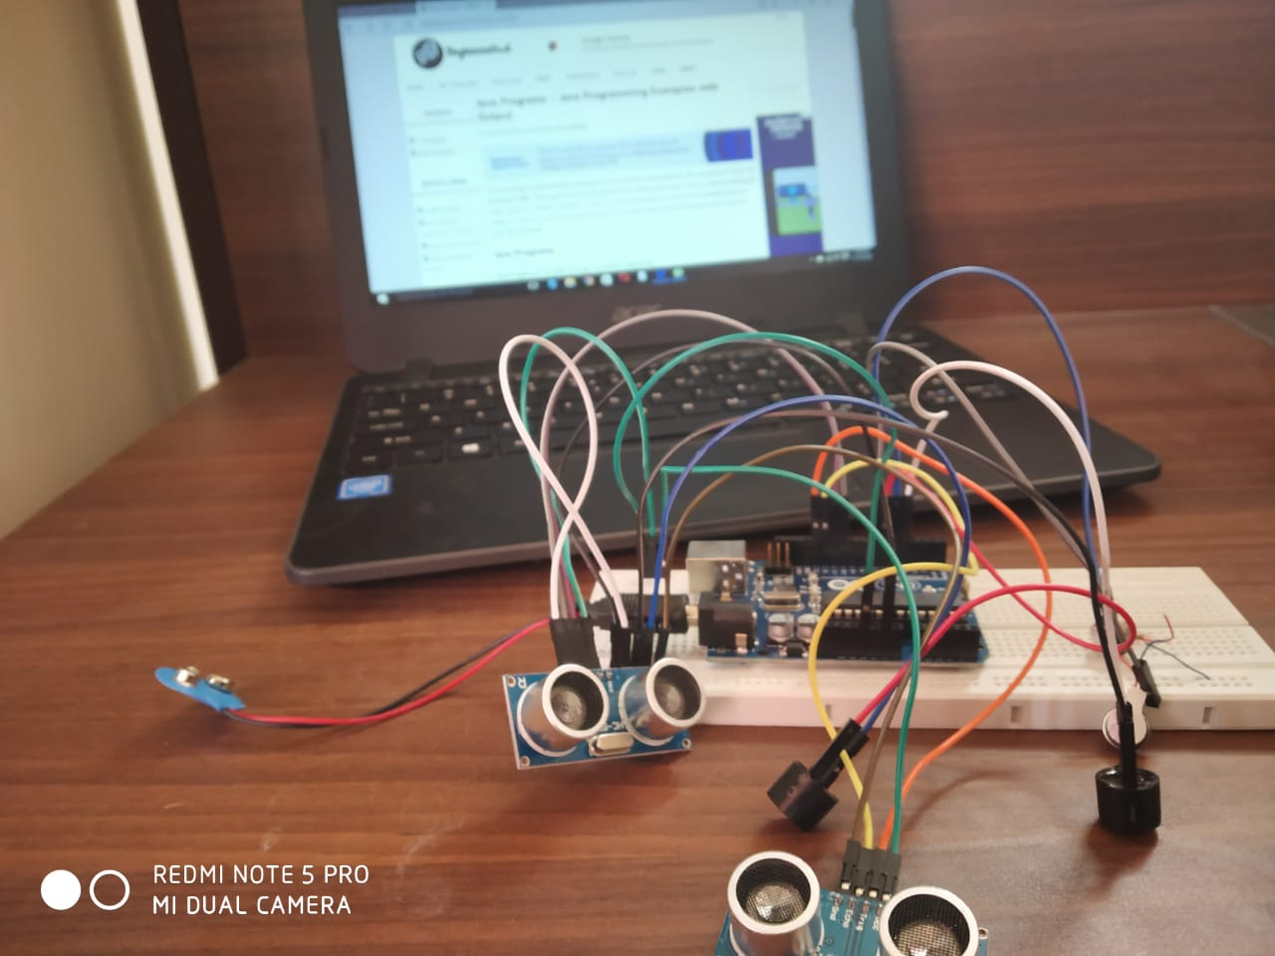
MODEL THIS WEEK:

Slide 9
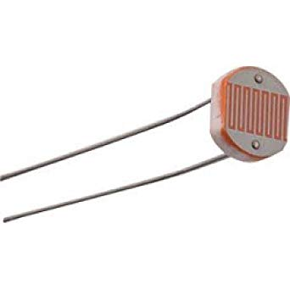
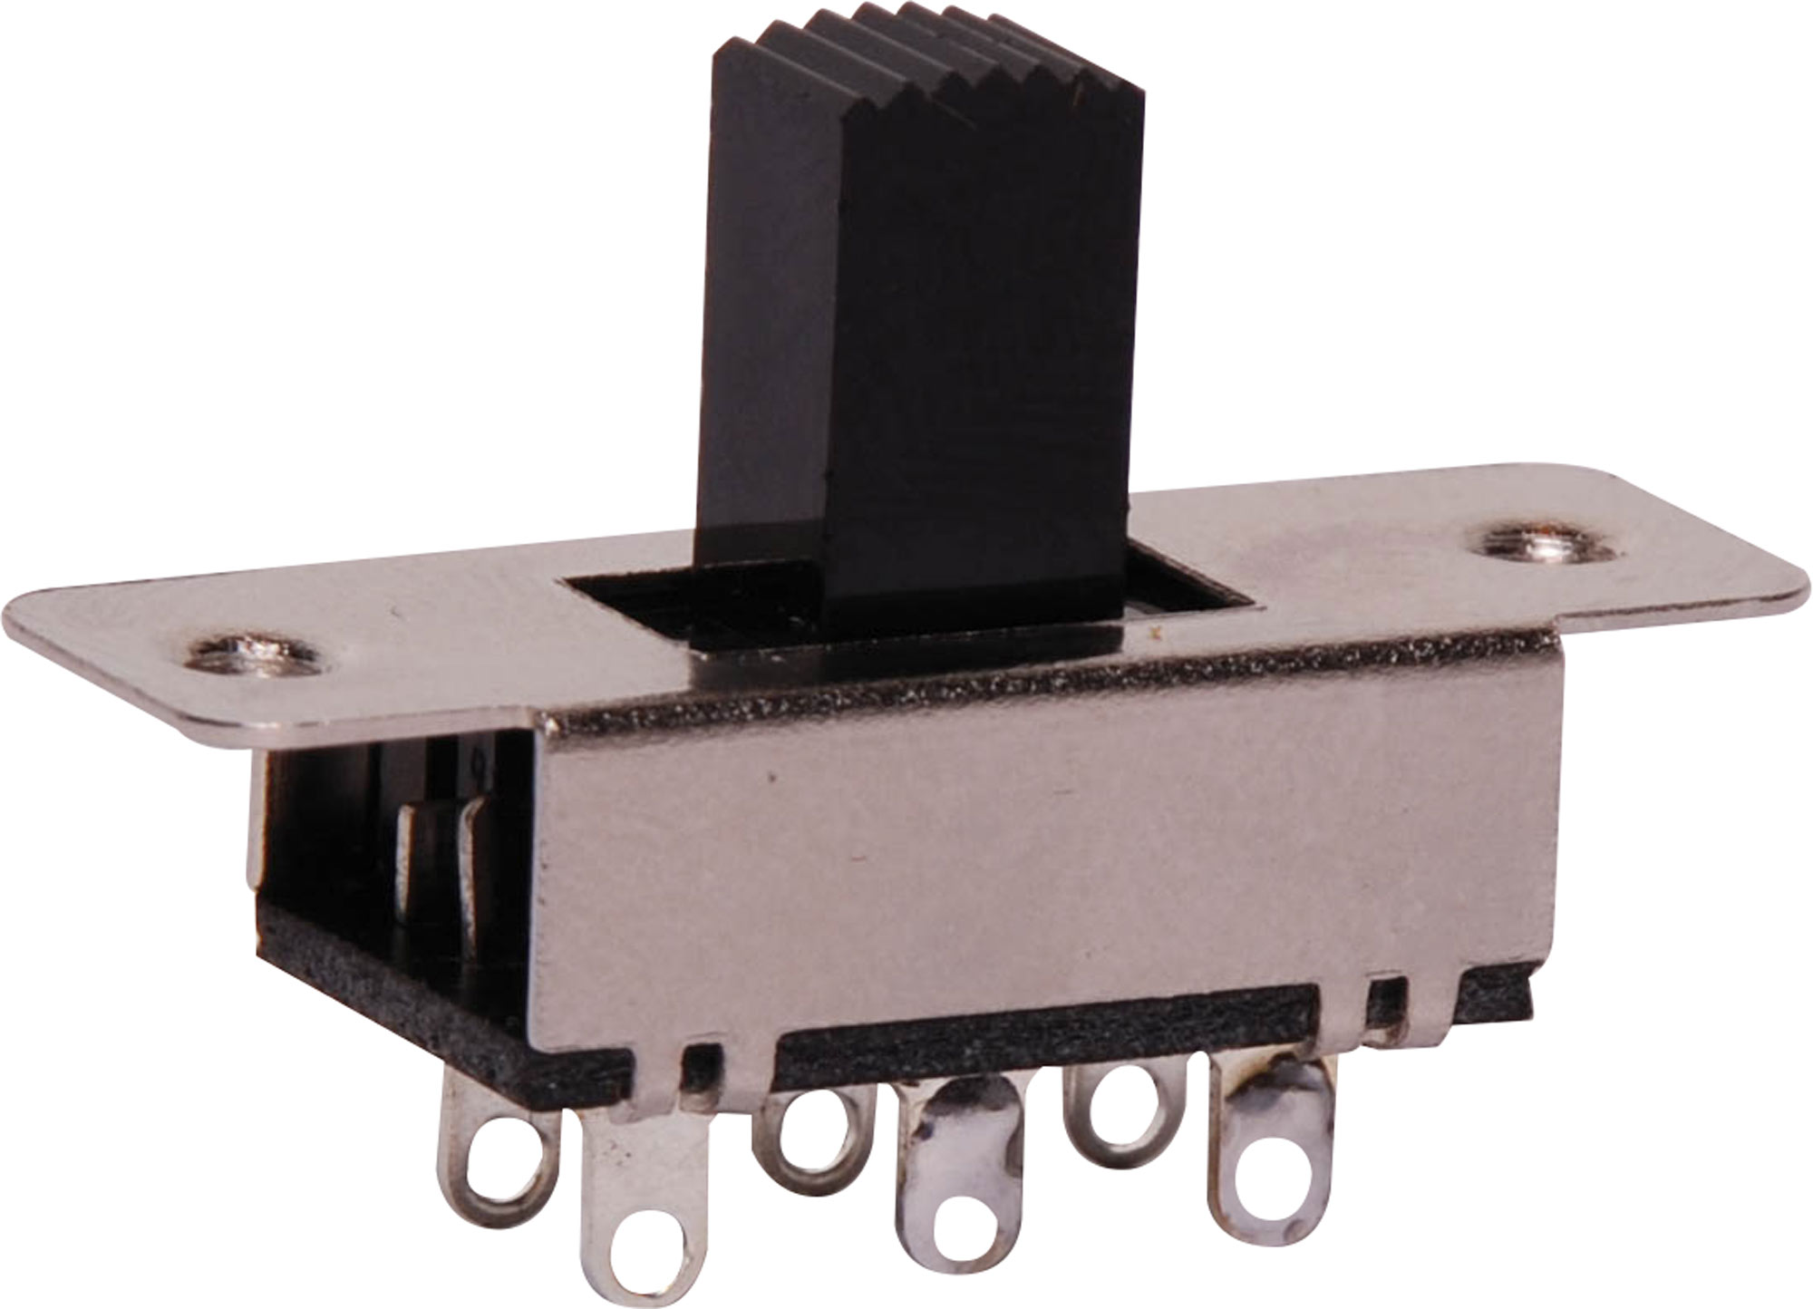
FUTURE IMPROVEMENTS TO BE MADE:
PHOTO RESISTOR:
IT IS USED TO SENSE WHETHER THE PERSON IN A DARK OR AN ILLUMINATED ROOM.THE PERSON CAN KNOW IF IT’S DAY OR NIGHT TIME.
USING A THREE WAY SWITCH , ONE ‘ON’ SIDE OF THE SWITCH MAKES THE PHOTRESISTOR WORK AND OTHER ‘ON’ SIDE MAKES THE ULTRASONIC SENSORS WORK.

Slide 10
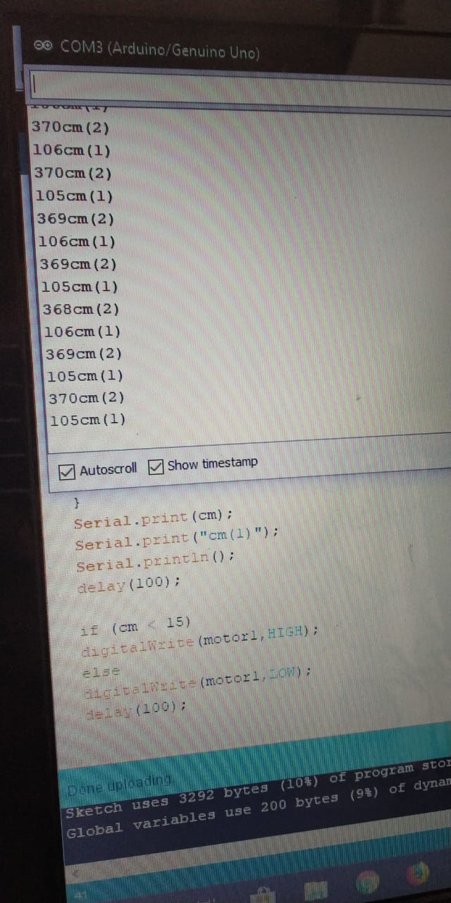
RESULTS:

Slide 11
REFERENCE:
https://www.robotechmaker.com/2016/11/third-eye-for-blind.html
www.google.com
www.Wikipedia.com

Slide 12
THANK YOU !!!!

